Slide 1
Growing the vine The vision of our school
At our school we strive to be the best that we can be, and to do good in our community and beyond. We cherish our traditional links with the Church, and our Christian values are at the heart of our school life and everything we do. Through our partnerships with other schools, parents, the Church and the community we enjoy a range of educational and social experiences, preparing us for the wider world and enabling us to be successful and giving in our lives ahead.

Slide 2
Our approach to communicating the vision .
We embrace a living faith in Christianity, one which spreads, grows and deepens.
Our image to convey this needs to be alive and organic.
We want something long-lasting and scripture related.
It needs a spiritual element and to uphold: Belong, Believe, Achieve; the values tree, and distinctive British Values.
It requires involvement of: staff, pupils, parents, governors, church and community.

Slide 3
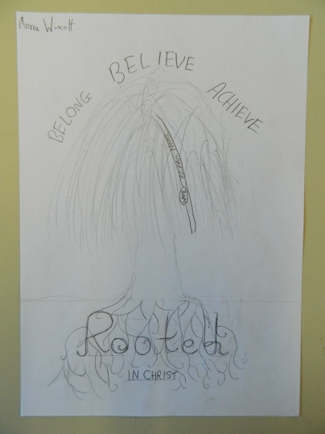
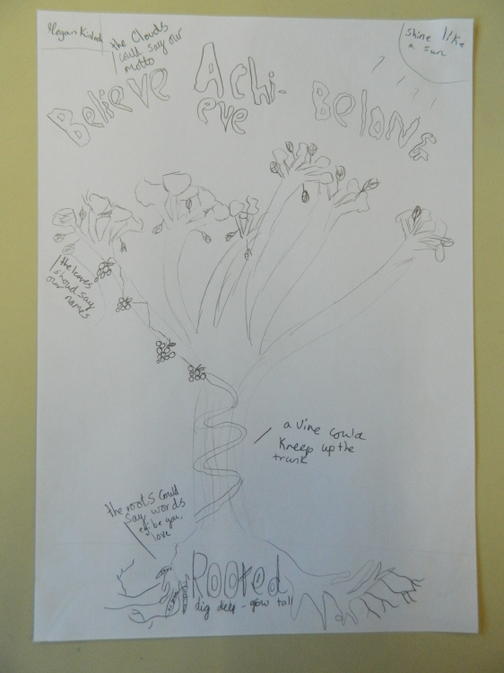
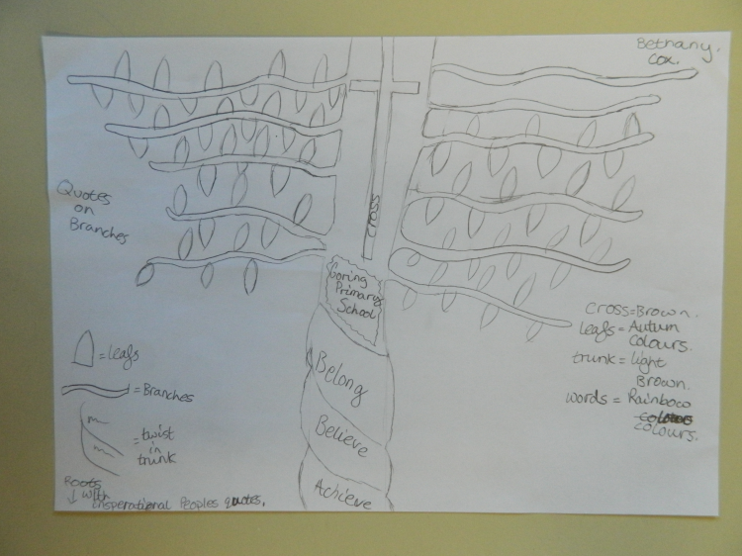
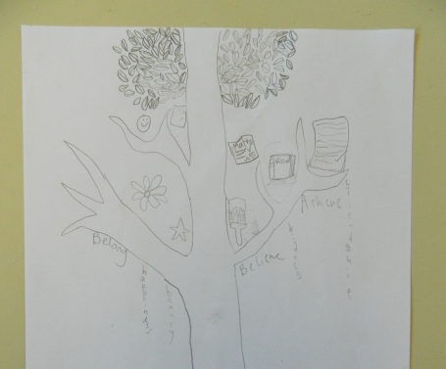
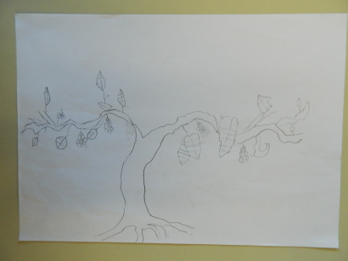
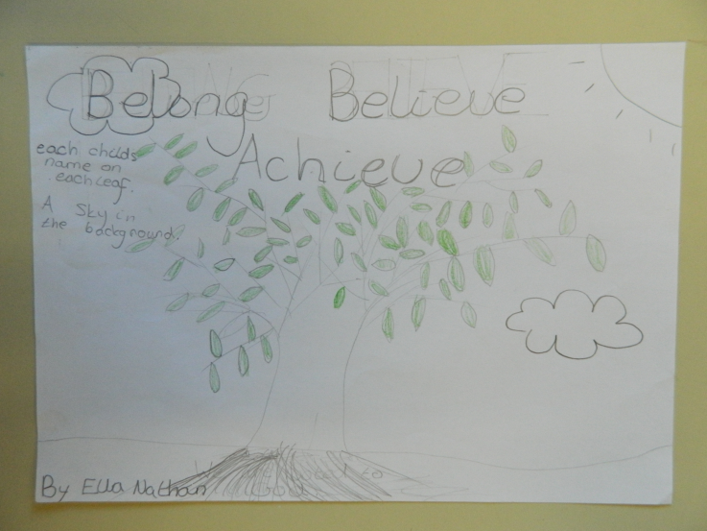
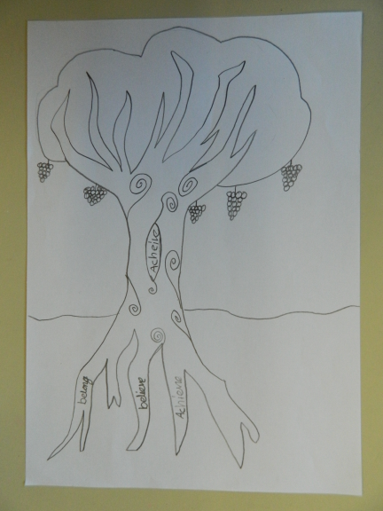
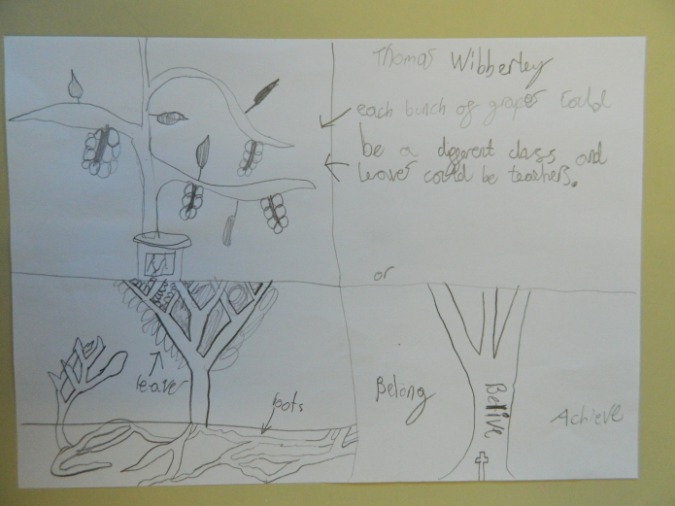
Wider involvement in the vine vision.
Children drew up visuals for the vision.
Staff, governors, church and parents have all commented on the vision statement, the values of Belong, Believe, Achieve and the supporting scripture verses.

Slide 4
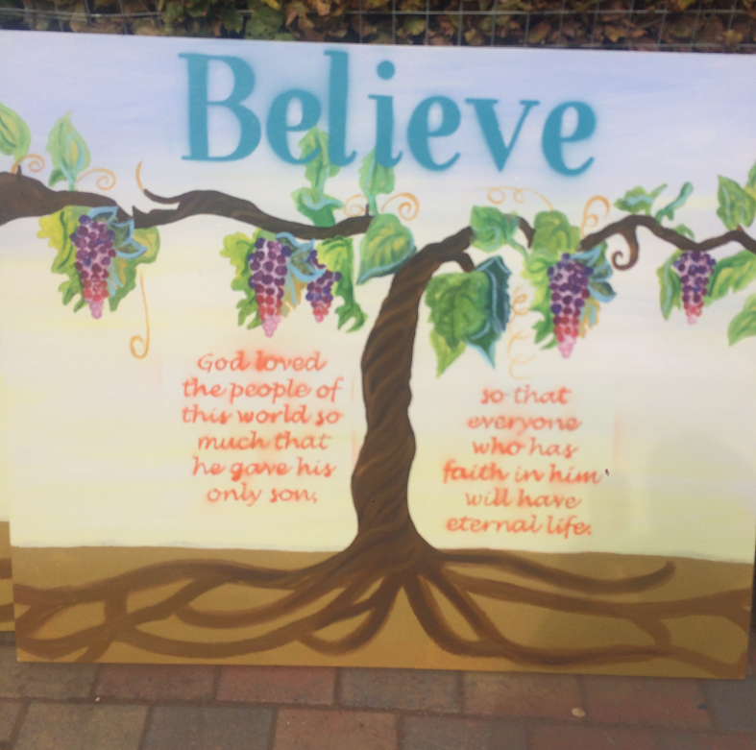
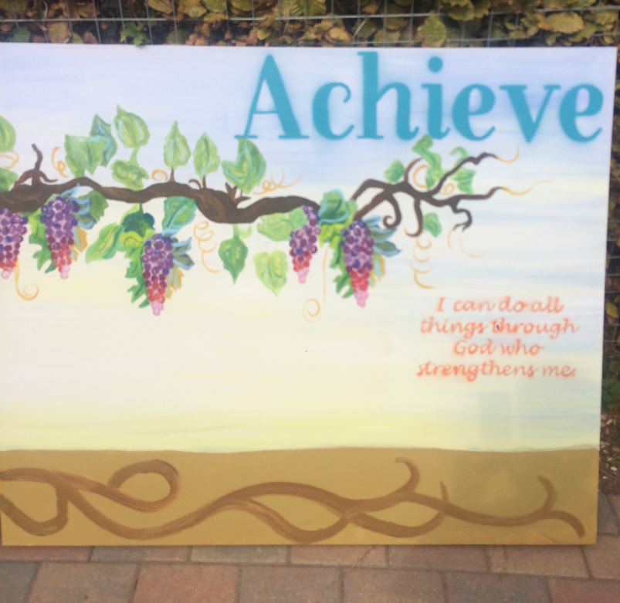
tW
The light behind the vine is God’s guiding light.
Grapes are the good fruit which comes from the well nourished vine.
We are the branches that grow into the world, holding out the leaves, and bearing fruit .
The expansive blue sky is home to Belong , Believe, Achieve held up high by the vine.
Rooted in good full soil provided
by God.
God is the vine, through him we can achieve great things.
I am the vine; you are the branches. If you remain in me and I in you, you will bear much fruit.
John 15:5
Notice this vine does not require a support frame, it is a spiritual vine which is nurtured by faith in God’s love, provision, guidance and love for one another.
Biblical verses are considered to be God inspired so are painted as flames. When God reveals himself in the bible he is depicted as fire.

